Slide 1
Power BI Adoption Framework
Empower every decision maker
Power BI Support

Slide 2


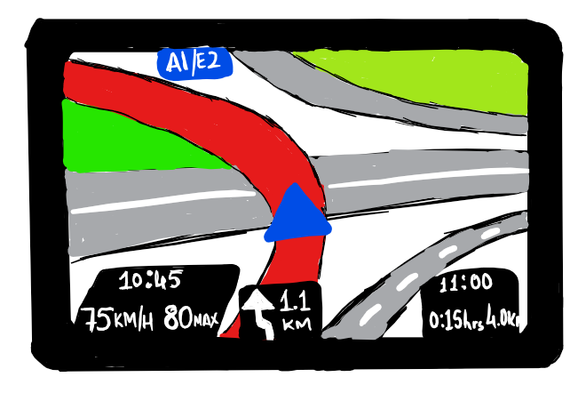
Types of Support
Break-fix
Minor Enhancements
Enablement

Slide 3
Break-fix
Mandatory Service
IT budget
Service knowledge is essential
Quick turnaround/ SLAs
Infrastructure/Service

Slide 4
Break-fix
Mandatory Service
Project budget
Project knowledge is important
Knowledge of the tools is essential
SLAs
Project

Slide 5
Minor Enhancements
Perceived as an essential service
Project Budget
Project knowledge is a nice to have
Knowledge of the tools is essential
Timescales agreed while scoping

Slide 6
Enablement
Organisational/Team Budget
Knowledge of the tools is essential
Real-time
Enablement hub

Slide 7
Break-fix / Minor Enhancements Options
Microsoft Power BI Support
Microsoft Premier Support
Internal Infrastructure Support
Internal BI Support team
Partners

Slide 8
Enablement Options
Centre of Excellence
Dedicated Power BI Enablement team
Lunch & Learn / Office hours
Internal website
Ongoing trainings
Advisory Service
Internal

Slide 9
Enablement Options
Power BI website, blogs, community portal
Online courses e.g. eDX
YouTube Power BI videos
Guy in a cube
Power BI User Groups
Community websites, blogs:
DAX Patterns
Power Pivot Pro
Chris Webb’s blog
Community

Slide 10
What do you need to consider when someone starts / changes role?
Actions
Document user rights changes
User from Gateway(s) – both admins and data sources
Pro license
Rollout / Removal of Power BI Desktop

Slide 11
What level of support will you give users?

Slide 12
Who will support Power BI?

Slide 13
Thank you

